Slide 1

VISVESVARAYA TECHNOLOGICAL UNIVERSITY Jnan Sangama, Belagaum, Karnataka-590014 Project Presentation on “Temperature based Automatic fan speed controller by Arduino” Submitted by
Name Of the Students | University Seat Number
Soundarya R | 1GG18ME029
Bharath S C | 1GG19ME404
Sharana Basava | 1GG19ME417
Somaning Bandi | 1GG 19ME419
Under the guidance of
Dr. Girisha H N
Assistant Professor
Department of Mechanical engineering
Govt. Engineering Collage Ramanagara-562159

Slide 2
Contents
Introduction
Block Diagram
Literature Survey & Literature Gap
Scope & Objective
Circuit Diagram & description
Methodology
Flow chart
Work carried out so for
Components used
Assembly and testing
Advantages and applications
Conclusion
References

Slide 3
Electric Fan is a vary simple device Consists of Rotating Blades used to move the air in the room.
As Compare to A.C fan Doesn’t change temperature of the they only move it.
It is non linear system, as we are considering to Rotate it according to the environment temp .(In households during the summer A.C is responsible for 60-70% of our electric bills).
A.C consumes 500 to 1440 Watts of current but Fan uses on 90Watts depend on Speed & size.
Electric fan is device that help us to stay cool in summer, while saving our money as well as protecting the environment by limiting the release of Carbon-di-oxide.
The main idea of this project is to replace manual settings of fan in with change in temperature so that it detects Human presence & temperature & Control speed automatically.
Introduction

Slide 4
Block diagram
AC FAN
Regulator Block
ARDUINO UNO BOARD
Ultrasonic Sensor
DHT 11
Sensor
LCD Display
Servo motor
Power block

Slide 5
Literature Survey
In the Above Journals Authors give a Detail Research on how to Control Fan Automatically By different types of Sensors, to Control the small sized Fan for CPU, & Run a Fan On the Battery power, But we are going to Control the Fan by using Arduino Board & Humidity & temperature Sensor (DHT11) and this Fan Runs on normal Electricity (i.e. alternate current) used in our houses there is no separate battery Required to run this Fan. It is More Economical and Effective to save Electricity.
SL.NO | Author | Journal | Description
01 | M A Mashud, Dilruba Yasmin, & M H Uddin. | International journal of science and engineering research, volume 6, issue 8 | Automatic room temperature controlled fan speed controller using PT-100” and drive circuit on low voltage power supply and the result of this satisfactory.
02 | A S Deepanshu verma, & Brajesh kumar | International journal of current research, Volume 8, Issue 04 | “Temperature based Automatic fan speed controller” by using Sensor(LM.5) using MCT2E Optocoupler & NE 555Timer.
03 | Ayesha siddika & sayeda Farzana Nasrin. | Global scientific journals, volume 6, issue 8, August 2018 | Design & development of Automatic fan control system using PIR &LM35sensor, In this they design the like fan is turn on/off by human detection, & it is most effective for power saving.
04 | Srinivas p, kavin kumar B & Arun venkat A | International Reaserch journal on advanced science hub, Volume 02, Issue 07, July 2020 | “Temperature based Fan Speed controller” in this they used Relay Switch, And Potentiometer for Battery, Transistor & other components to Control the Fan.
Literature Gap

Slide 6
In the proposed system microcontroller plays a vital role in the smart systems development,
Microcontrollers have become an essential part in the present technologies that are being presented daily.
In this discusses Human detection & temperature based fan speed control and monitoring system using an Arduino system. This system is used to control the cooling system automatically based on the room temperature.
The system requires an Arduino board to implement a control system to this project since this is proposed to control the cooling system and it is very important to know Arduino Controlled system well
Scope and Objective of Proposed system

Slide 7
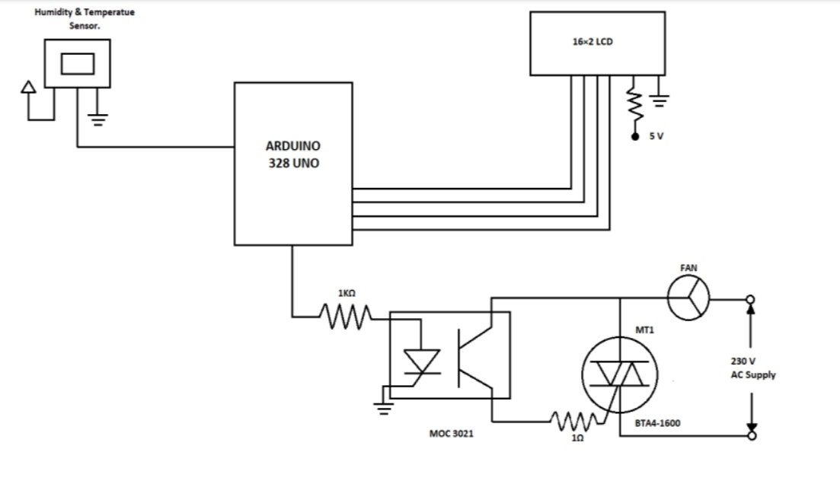
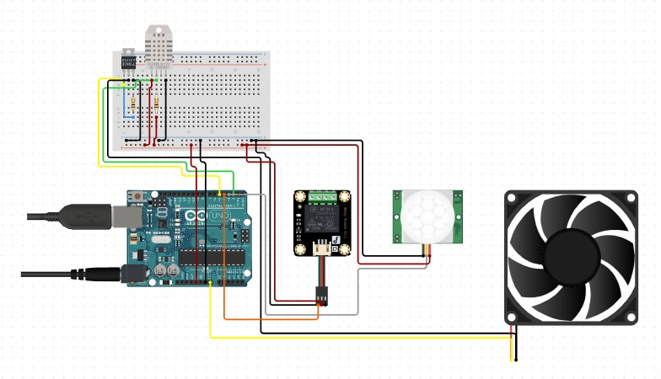
Circuit diagram of the Human detection & Temperature based fan control is shown in the bellow fig. It is built Arduino Uno board (board 1). 16*2 LCD, Ultra sonic Sensor, temperature sensor DHT11 and few other components. Arduino is the heart of the circuit as it controls the function
Circuit Diagram & description

Slide 8
The Human detection & temperature-based fan speed Control system can be done by using an electric circuit an Arduino board.
Now Arduino board is very Progressive among all electronic circuits, thus we employed Arduino board for fan speed control.
The Proposed system is designed to detect the Human Presence and send that information to the Arduino board.
After information received the temperature of the room is sensed by the sensor and send that information to the Arduino board.
Then Arduino board executes the contrast of current temperature and set temperature based on the inbuilt program of the Arduino.
The outcome obtained from the Operation is given through the o/p port of an Arduino board to the LCD display of related data.
The generated pulses from the board which is further fed to the driver circuit t get the preferred out put to the fan.
Methodology

Slide 9
Flow chart
Start
Ac or DC power supply
Ultrasonic Sensor
Presence of human
Fan start the function
Temperature control the speed of the Fan
end

Slide 10
Work carried out so far
Related project work journals are studied.
Project work cost is estimated.
Algorithm generation(Fan speed and temperature)
Program design Completed
Program redesigned for the Human detection Sensor
Selection of Components ( Material ) needed
Procurement of materials
Assembling the Components And testing

Slide 11
Related project work journals are studied.
SL NO. | AUTHOR | JOURNAL | DISCRIPTION
01 | Ankit bagal, Sachin chakane | journal of science and technology, ISSN:2456-5660 volume 6, special issue 01, August 2021 page number 222 | “automatic fan speed control using microcontroller” In this they described how to control fan automatically
02 | Jivan jyoti mahakud, arunkumar das | international journal of innovative technology and exploring engineering (IJITEE) ISSN:2278-3075, volume 8 issue-11, September 2019 | “smart fan speed controller” In this they give details on controlling of fan speed by IOT technology and mobile.
03 | Shivani mohite, shivashankar Adsule | international conference of communication and information processing(ICCIP-2020) | “automatic temperature based fan speed control” In this they discuss controlling fan speed.
04 | Nikita Bagali, Geeta Navalyal | International journal of Advanced research in computer and communication Engineering | “Efficiently consume the electric power, tracking the objects with IR sensor and Controlling the fan on and off.
05 | Keerathiburt Kanchanasation | IOP Conference Series: Material science and engineering | Automatic Control and turning on /off for fan by Temperature and Ultrasonic sensor

Slide 12
Project work cost is estimated
SL N O | MATERIAL NAME | Quantity | COST
01 | Arduino Uno board | 01 | 1600
02 | Dht-11 Sensor | 01 | 300
03 | Servo motor | 01 | 680
04 | Fan | 01 | 2500
05 | 12V power adapter | 01 | 250
06 | Ultra sonic Sensor | 02 | 546
07 | LCD and 12 C device | 01 | 250
08 | Electrical materials | - | 1000
09 | Other expenses | - | 1874
Total |  |  | 9000

Slide 13
Automatic fan speed control system using Arduino
We are using the following algorithm to control the speed of a fan according to temperature. For sensing the temperature DHT 11 sensor has been used. The program of the Arduino will done by C++ language.
Algorithm generation
1.T=0 fan Speed =0 (where T= temperature in degrees)
2. T= get Temp() // Get current temperature from temperature sensor(i.e., DHT11 sensor)
3. Now compare the value of T with range of temperature and set the fan Speed according to that
a) if T>=19ºC and T<=20ºC
Fan Speed = 25% (260 RPM)
b)If T>=20ºC and T<=24ºC
Fan Speed = 50%(295 RPM)
c)If T>=24ºC and T<=28ºC
Fan Speed = 75%(320 RPM)
d)If T>28ºC
Fan speed = 100%(350 RPM)

Slide 14
Temperature sensor(DHT11)
Arduino Board
Ultrasonic sensor
Fan
LCD Display
Servo motor
Connecting wires
Selection of Components ( Material ) needed

Slide 15
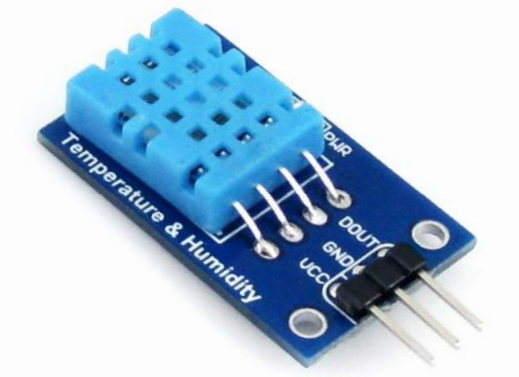
A humidity sensor senses, measure &
regularly reports the relative humidity in
the air. It measures both moisture &
temperature
Relatively humidity, expressed as a percent,
is the ratio of actual moisture in the air to the
highest amount of moisture air at that
temperature can hold.
Specifications:
Operating voltage: 3.5V-5.5V
Temperature range : 0ºC to 50ºC
Humidity range : 20% to 90%
Accuracy :±1ºC and ±1%
Temperature sensor(DHT11)

Slide 16
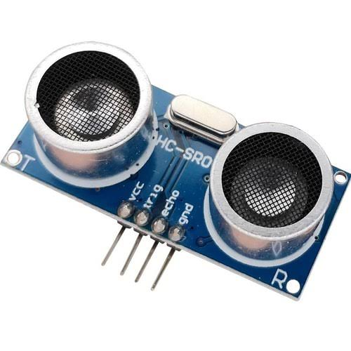
Ultrasonic sensor measure the distance to the target by measuring
The time between the emission and reception. An optical sensor has a
Transmitter and receiver, whereas an ultrasonic sensor uses a single
ultrasonic element for emission and reception.
The components include
Single bit out put
Small size makes it easy to concel
Compatible with all types of microcontrollers
5V till 20V operational with <100uA current draw
PIR sensor

Slide 17
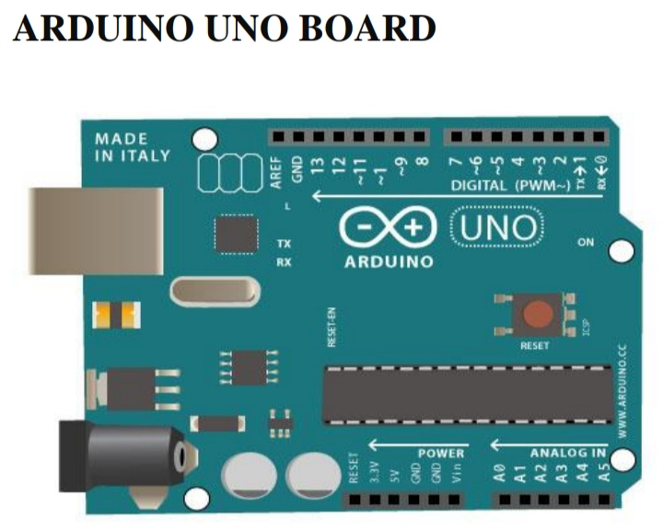
An arduino is an open-source microcontroller development
board.
Arduino to read sensor & control things like motors &
lights.
This allows you to upload Program to this board which
can then interact with in the real world. With this, you can
make devices which respond & react to the world at large.
Specification:
Microcontroller : ATmega328
Operating voltage: 5v
Input voltage (recommended) : 7-12V
Digital I/O pins : 40mA
Dc current for 3.3V pin : 50mA
Arduino Board

Slide 18
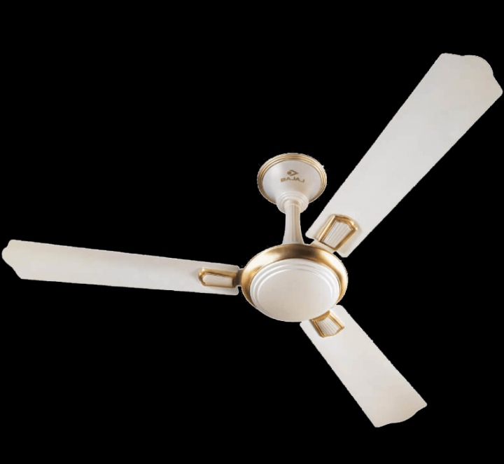
Electric Fan is a vary simple device Consists
of Rotating Blades used to move the air in the room.
Electric fan is device that help us to stay cool in summer,
while saving our money
Fan is more Economic And More Convenient for the middleclass
families
Specification:
Number of blades: 03
RPM : 300to 350 rpm
Consumption in watts : 75
Fan

Slide 19
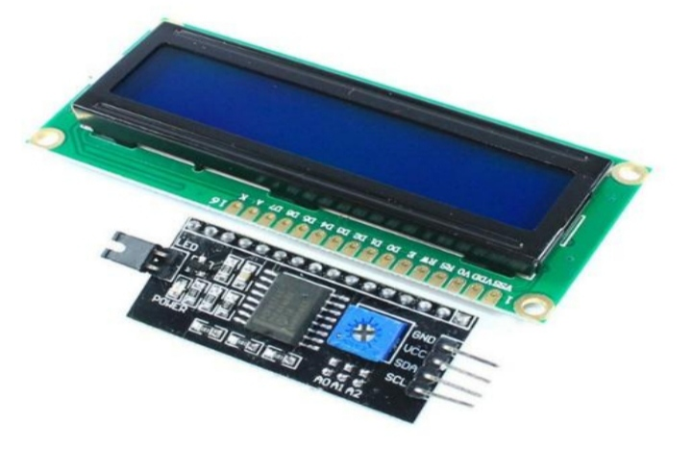
IC/12C Interface adapter module is used for 16*2 LCD Display.
It uses the PDF8574tIC chip which converts 12C serial to parallel
data for the LCD display. Also this Interface module simplifies
connecting an Arduino to a16*2 LCD using only 4 wires.
Specifications:
Operating voltage is 4.7V to 5.3V
Alphanumeric LCD display module, meaning can display alphabets and numbers
Consist of two rows and each row can print 16 characters
LCD Display (12Cbased LCD)

Slide 20

A servo motor is Electrical device which can push or rotate
an object with great Precision
If you want to rotate & Object at some specific angles or
distance then you use servo motor.
It is just made up of simple motor which run through servo
mechanism.
Specifications:
Gear type : plastic
Rotation :0 – 360º
Operating voltage : +5V
Connecting connects the whole circuit and make Connection with them to work Properly.
Servo motor
Connecting wires

Slide 21
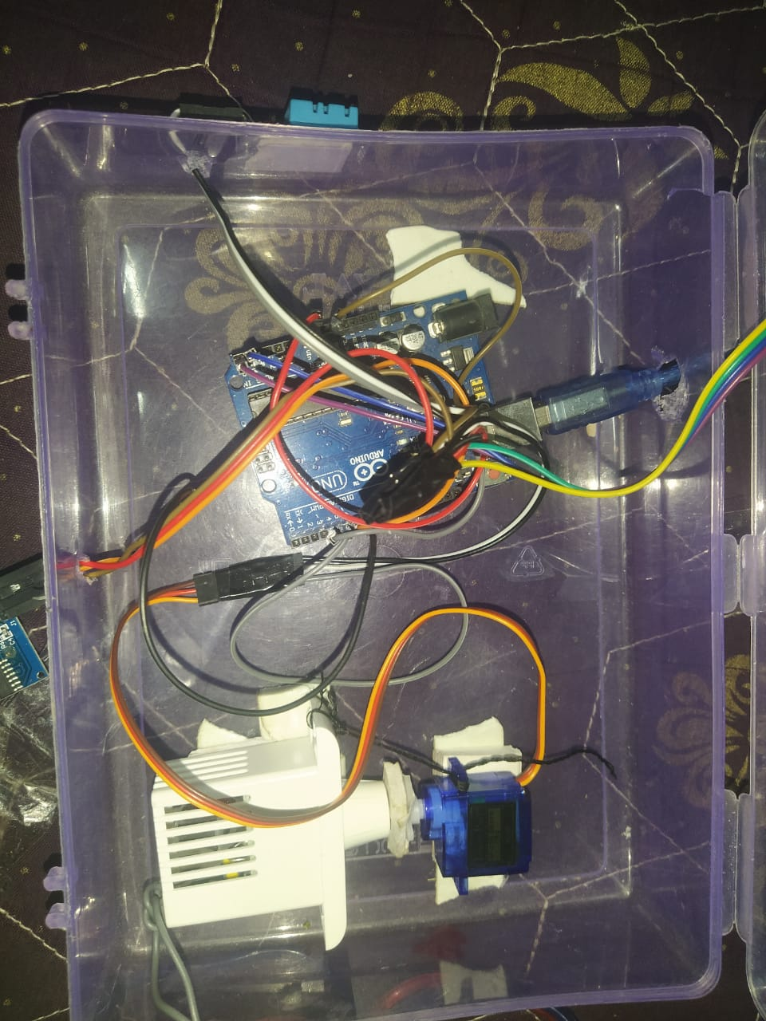
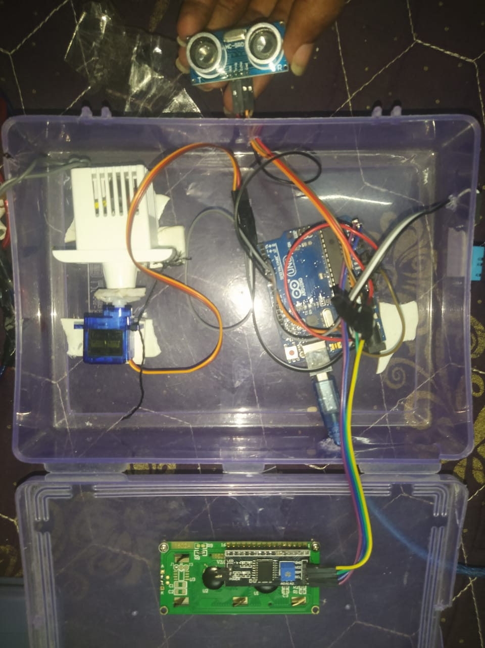
Assembling the Components And testing

Slide 22
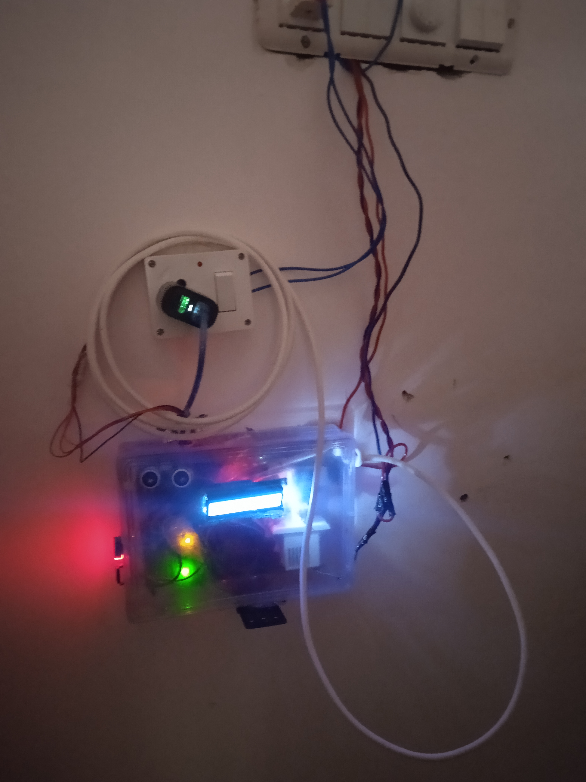
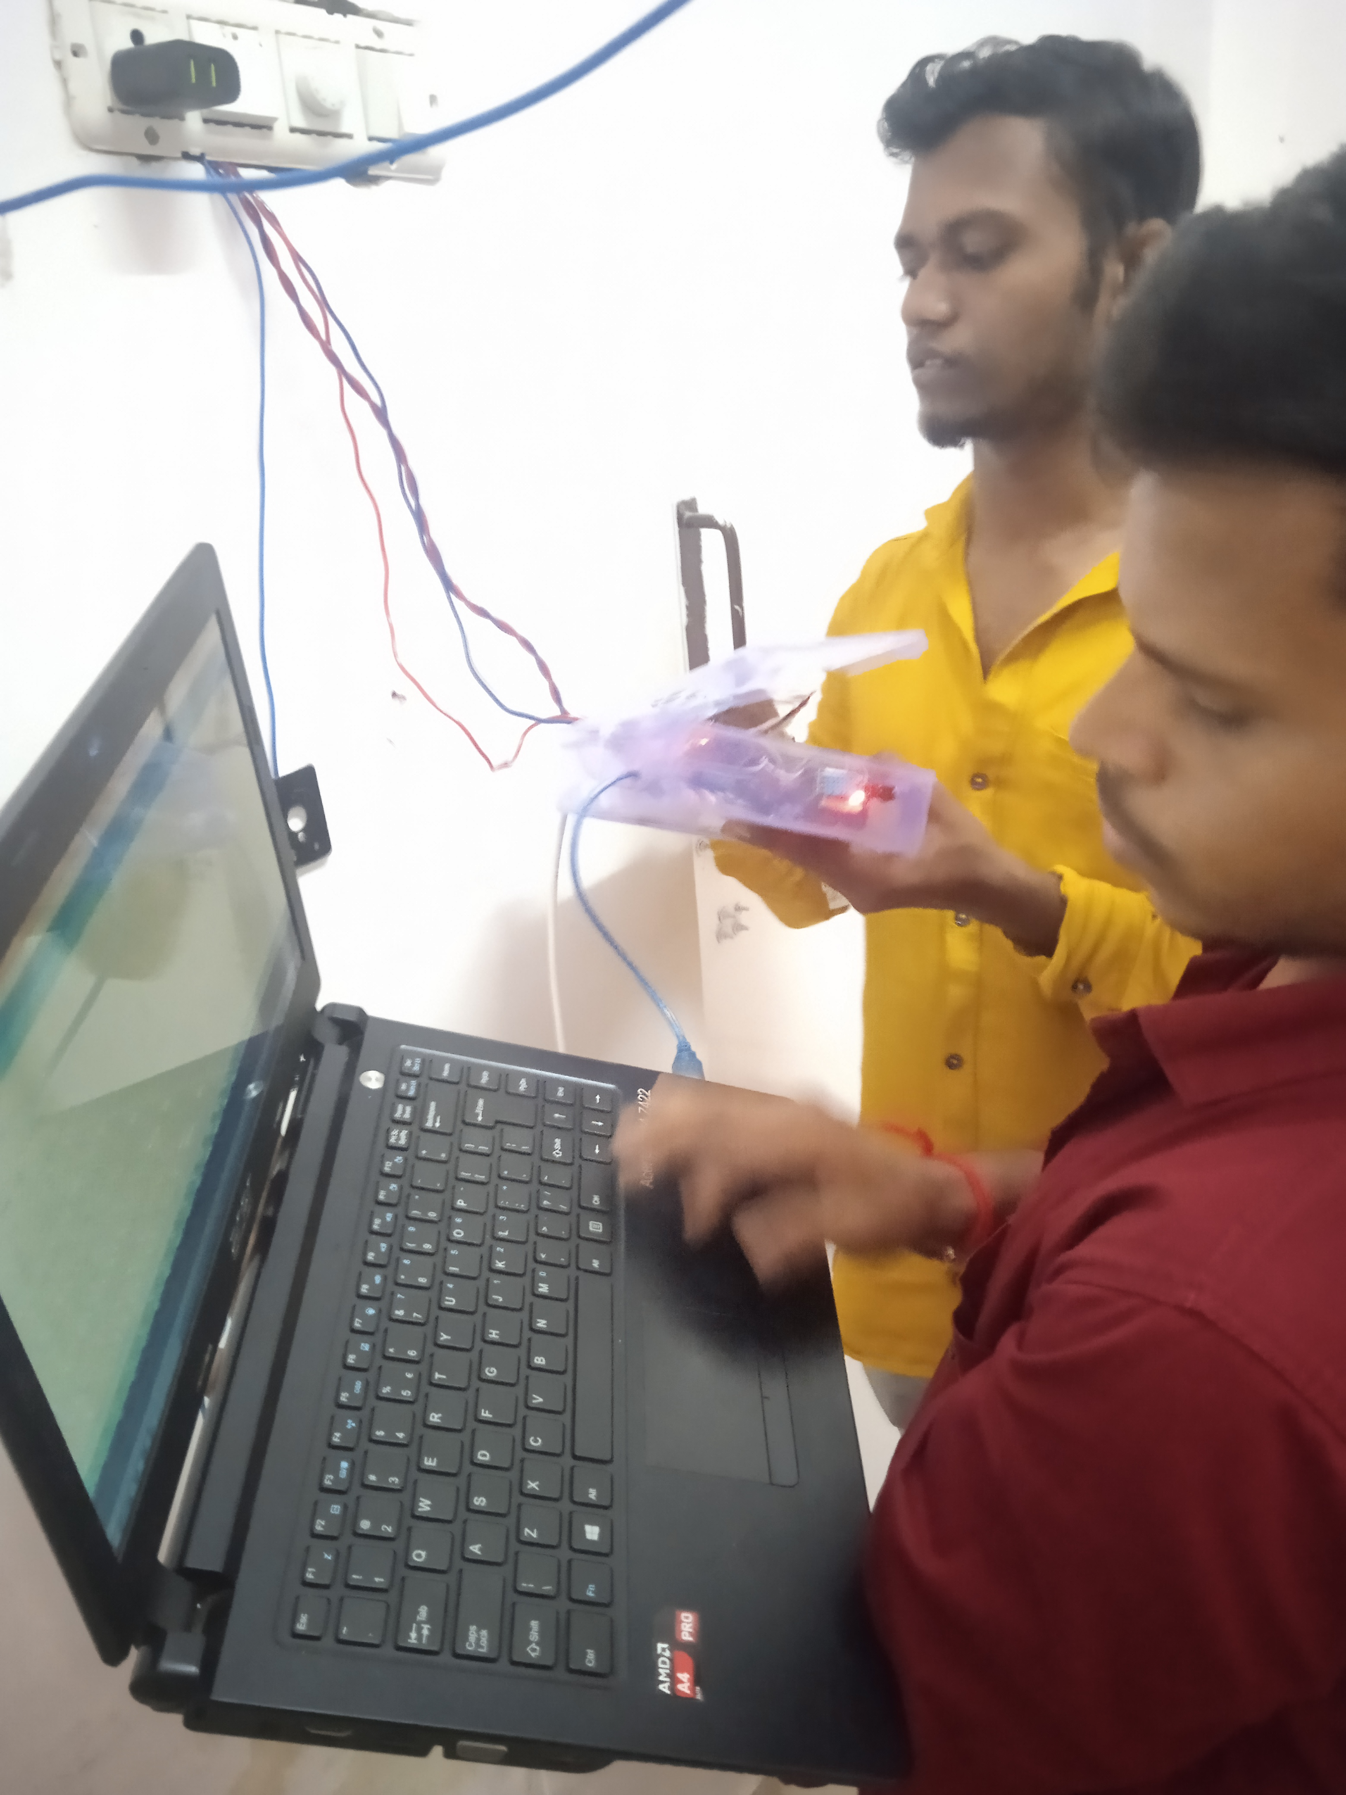
Installation of the system
Here the system is placed in a particular position through which it can detect the human Presence, and then wiring is done with the connection to fan and electrical switch board, and the program is changed according to the distance by which Ultrasonic sensor can presence the human presence

Slide 23
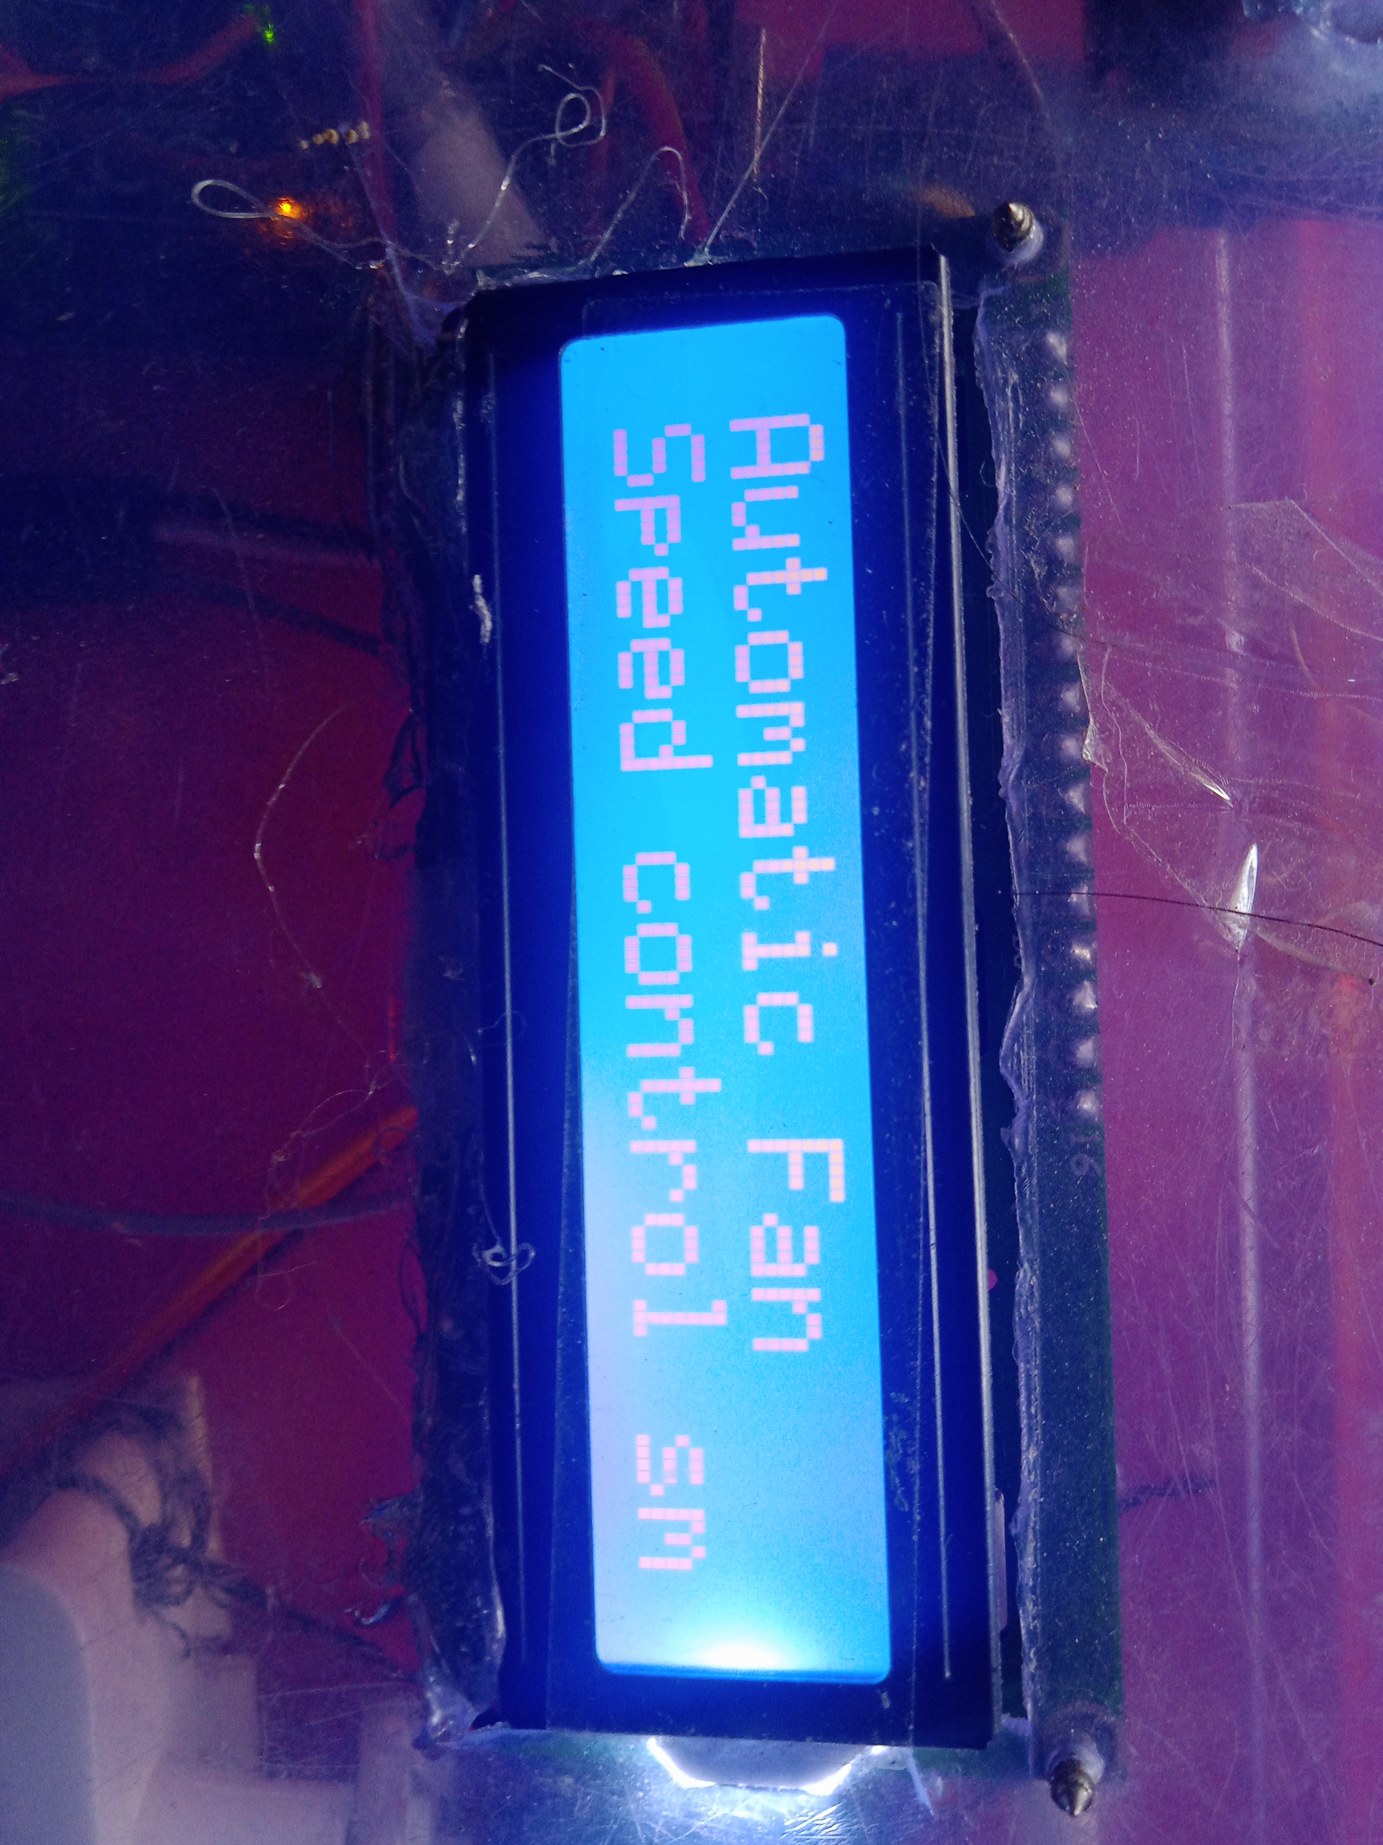
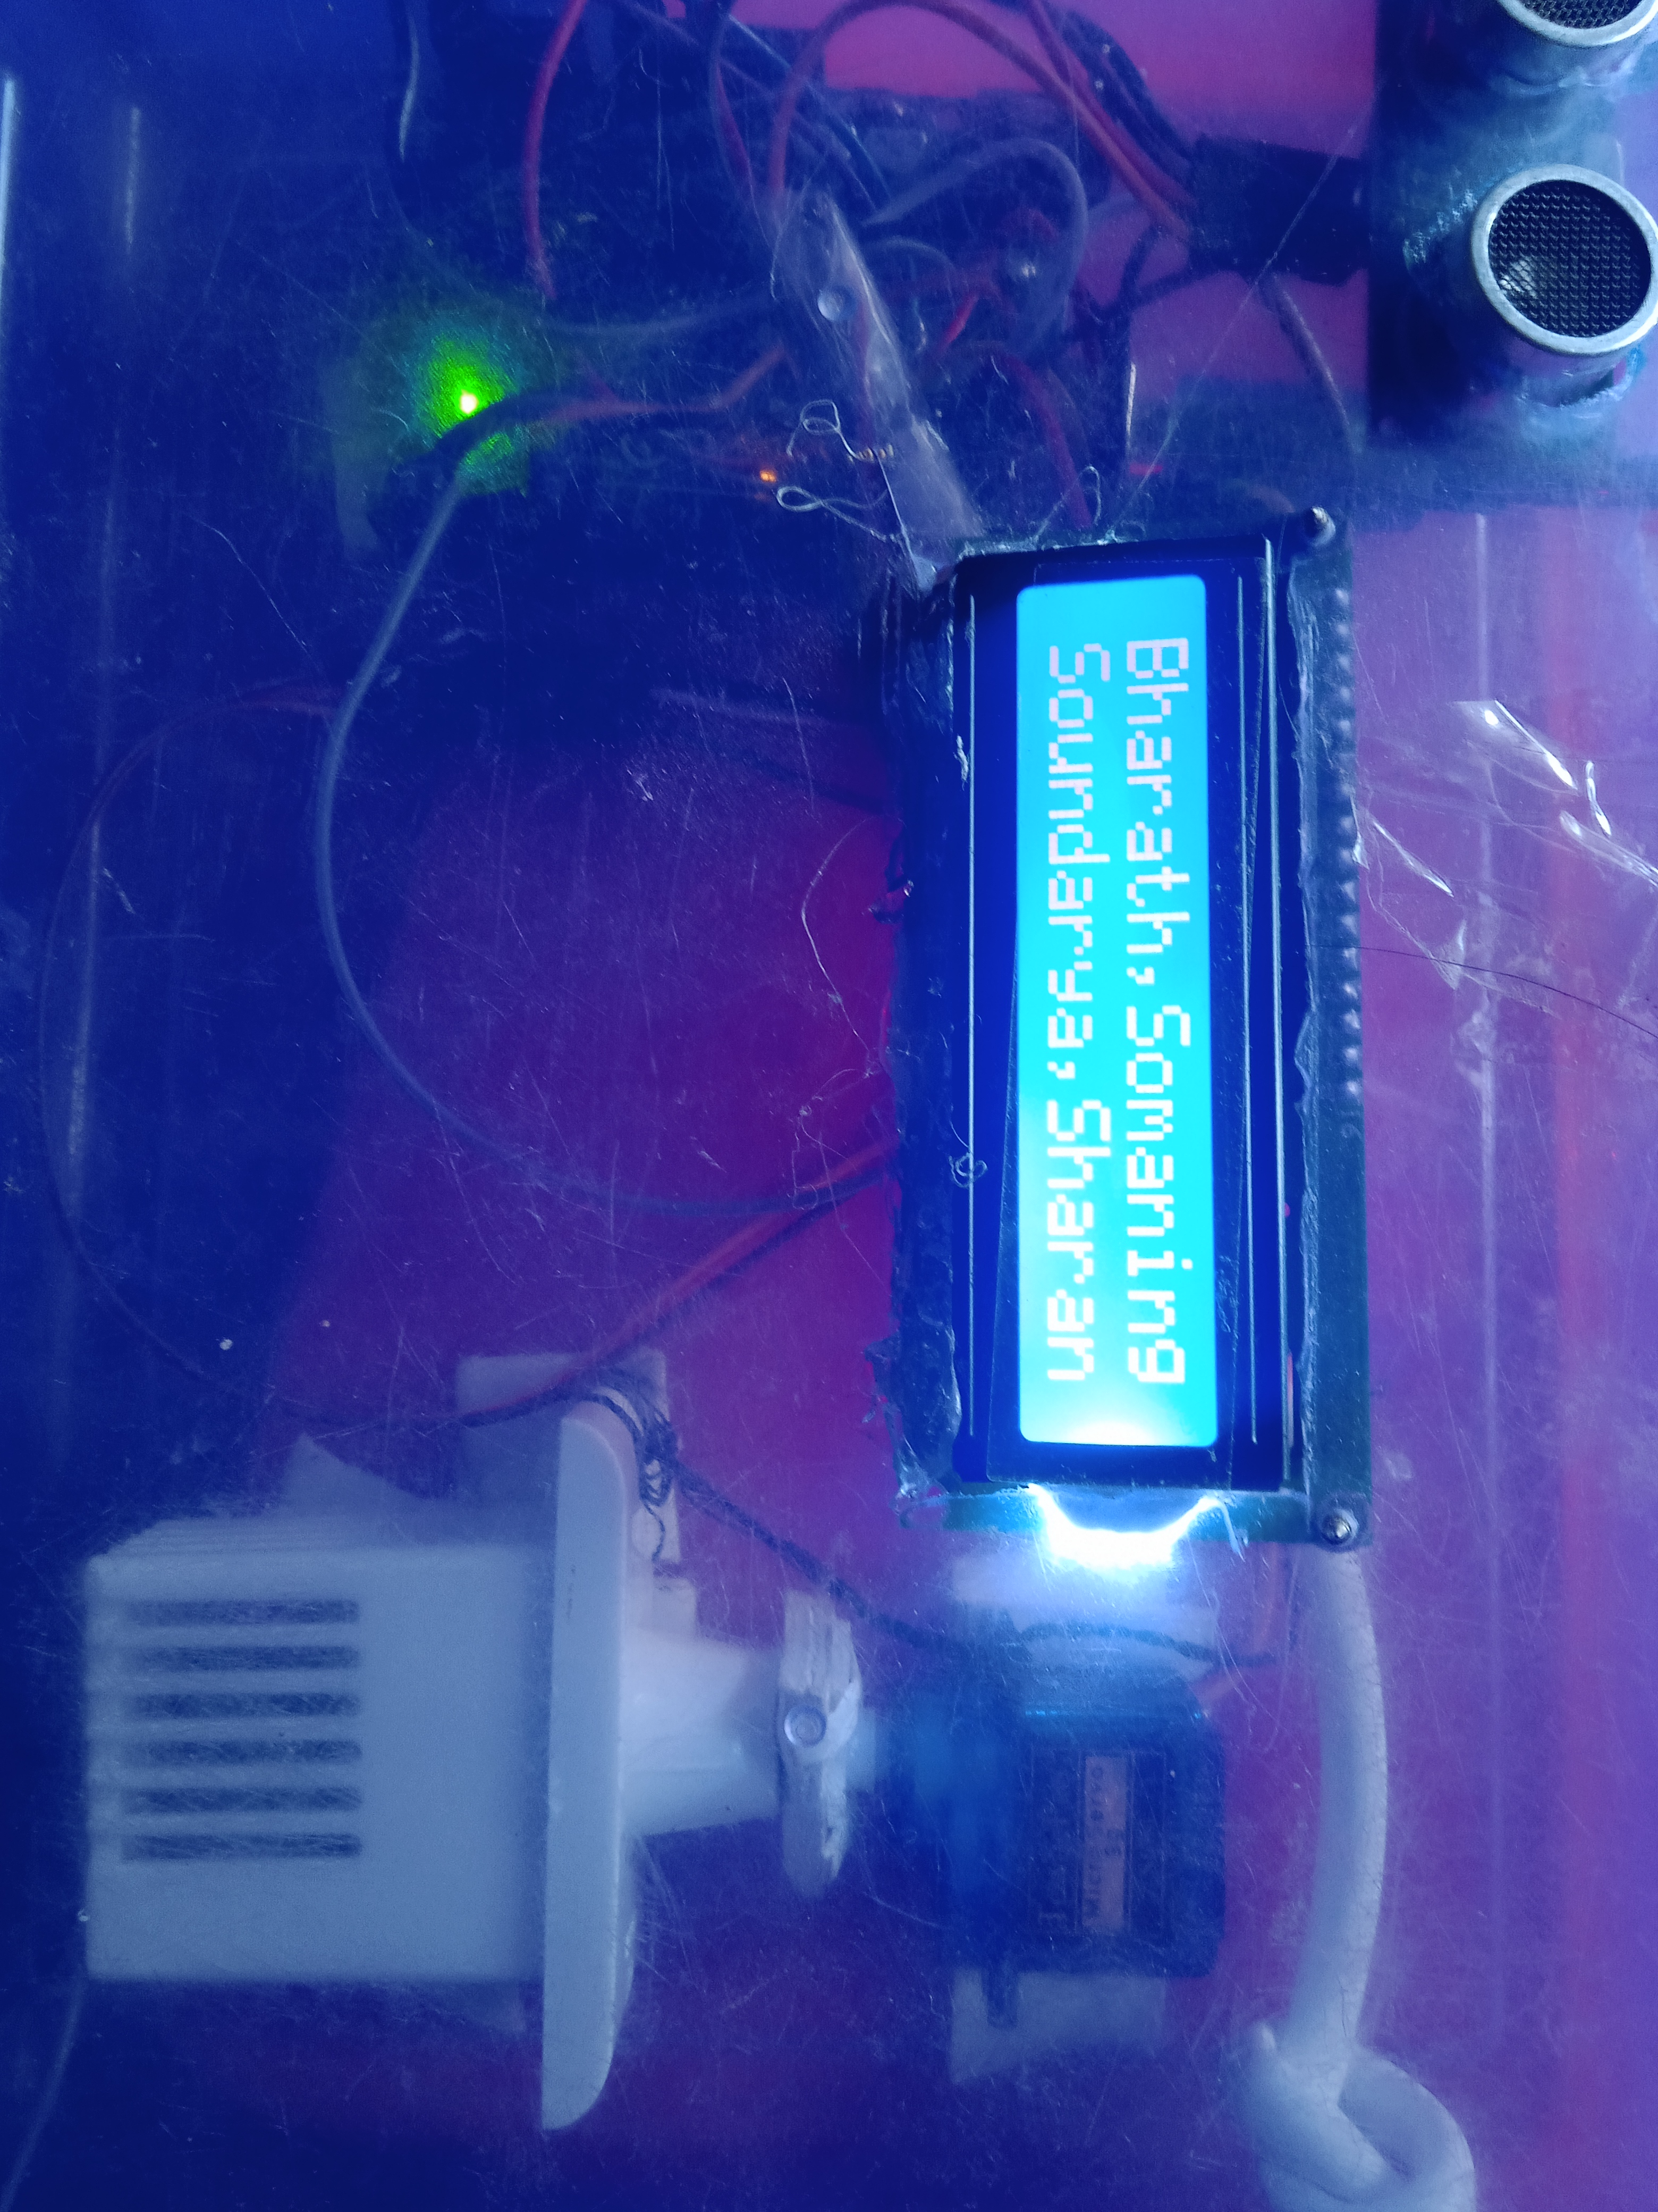
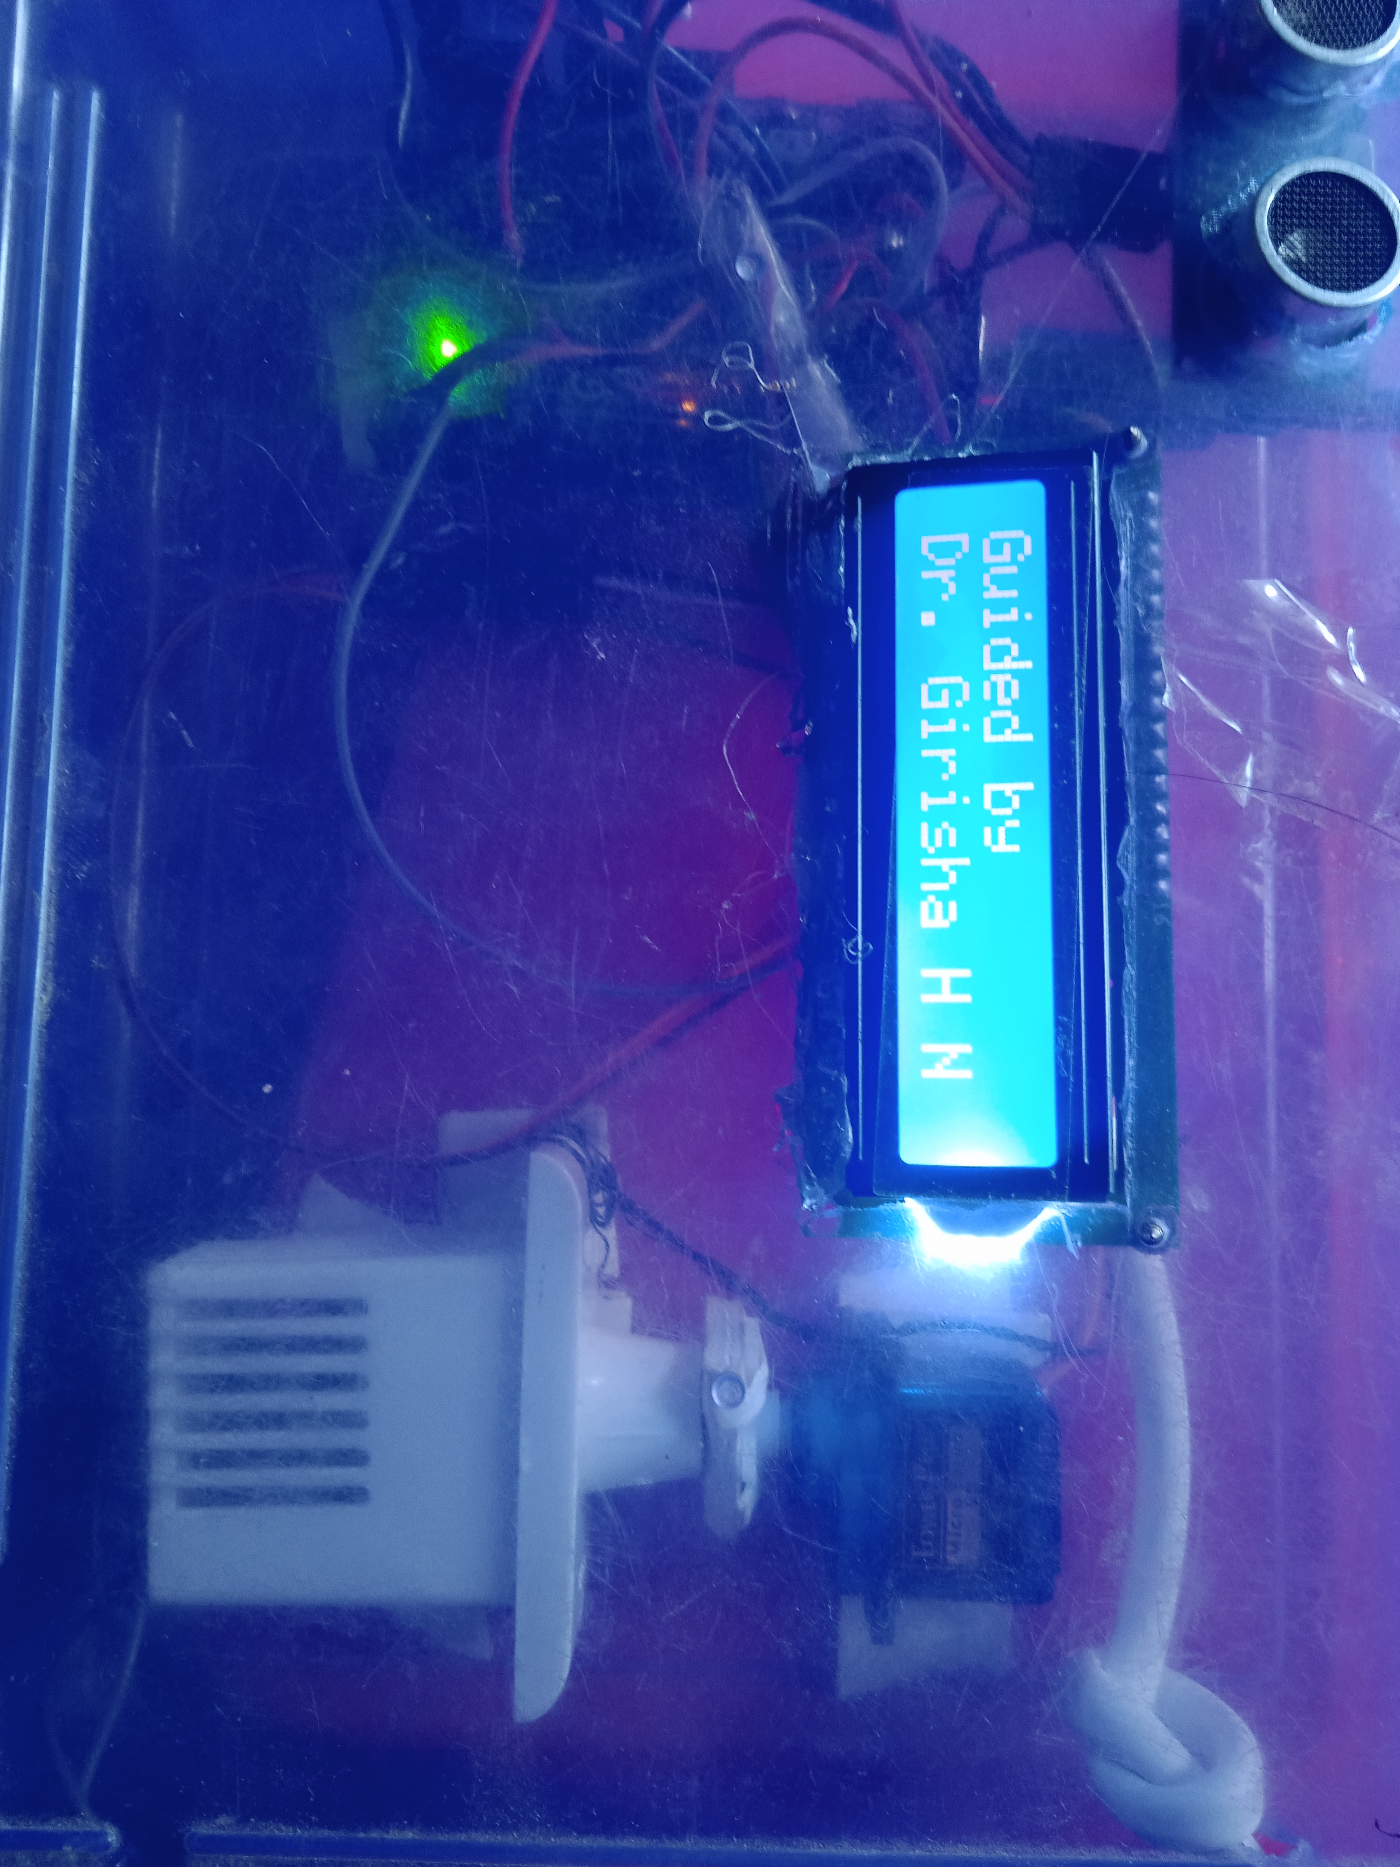
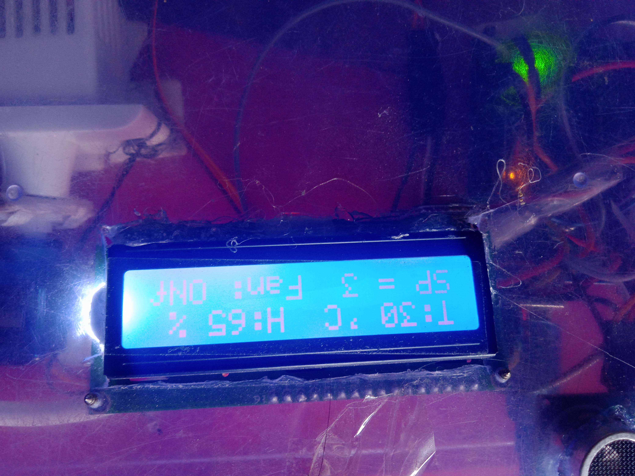
Functionality check

Slide 24
Advantages and applications
Manual effort is reduced.
Operating time is less.
Power consumption is less.
Design is very simple.
Net weight is less.
Maintenance cost is less.
Smoother operation.
By further modification the drive or movement can be made Automatic.

Slide 25
APPLICATIONS
Domestic purpose.
Hospitals.
Auditoriums.
Schools and Colleges.
Industries

Slide 26
Conclusion
Using this fan design, the power consumption is reduced as the speed of fan is
varied according to the temperature conditions. This design of controlling fan
speed is appropriate according to modern needs and the self-regulatory
mechanism is proposed as a viable alternative to manual fan speed controlling
systems i.e., regulators. Temperature based automatic control systems can be
used in the field of Internet of Things (IoT), to design intricate electronic
circuits, which can potentially solve real life problems.

Slide 27
International journal of science and engineering research, volume 6, issue 8, august -2015 ISSN 2229-5518, page no 1780. By M A Mashud, Dilruba Yasmin, & M H Uddin
International journal of current research, Volume 8, Issue 04, pp.29436-29440 April 2016, ISSN 833X, by A S Deepanshu verma, & Brajesh kumar
Global scientific journals, volume 6, issue 8, August 2018, ISSN 2320-9186 by Ayesha siddika.
International Reaserch journal on advanced science hub, Volume 02, Issue 07, July 2020 page no 159, by srinivas p, kavin kumar B & Arun venkat A.
Malvino,A P.& Bates, DJ.2006. “Electronic principles” McGraw-Hill Publisher USA.
Jing L, Liu D & Yang B2004 Smart home Research Proc. Of 2004 Int. Conf. on Machine learning & Cybernetics(IEEE Cat. No.04EX826)2pp 659-63.
S. Verma , A Das, S Dey, P Chowdhury, Automatic Temperature Controlled Fan using Thermistor, ISSN:2321-1156, International Journal of Innovative Research in technology & Science(IJIRTS) july2016.
References

Slide 28


